Slide 1

Talend
(HANDBOOK)

Slide 2
Contents
ETL
Talend Overview
Why?
Functionalities
Architecture
Talend Configuration
Installing
Talend Project
Demo Project
Job Creation
Talend Components

Slide 3
Contents
Talend Advance
Meta Data Handling
…

Slide 4
ETL for Analytics
Extraction, Transformation and Loading (ETL) processes are critical components for feeding a data warehouse, a business intelligence system, or a big data platform.
An ETL Process retrieves data from operational systems and pre-processes it for further analysis by reporting and analytics tools.
The accuracy and timeline of the entire business intelligence platform rely on ETL processes.

Slide 5
ETL
Extraction of the data from production applications and databases (ERP, CRM, RDBMS, files, etc.)
Transformation of this data to reconcile it across source systems, perform calculations or string parsing, enrich it with external lookup information, and also match the format required by the target system (third normal form, star schema, slowly changing dimensions, etc.)
Loading of the resulting data into various business intelligence (BI) applications: Data Warehouse or Enterprise Data Warehouse, Data Marts, Online Analytical Processing (OLAP) applications or “cubes”, etc.

Slide 6
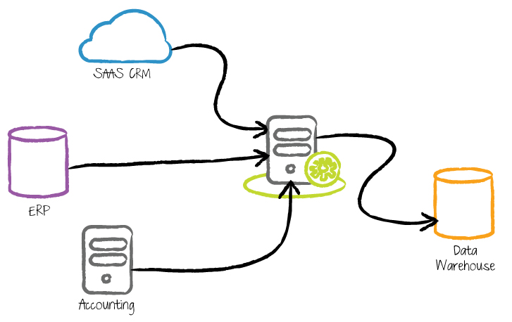
ETL
Sources – Talend – Data Warehouse

Slide 7
Talend
A highly scalable and fast execution open source platform.
Broad data integration connectivity.
Built-in advanced components
ETL including string manipulations, slowly changing dimensions, automatic lookup handling, bulk load support and data mapping tools that can handle complex data mappings.
Business-oriented process modeling
Ensures proper communication between IT and lines of business.
Fully graphical development environment.

Slide 8
Talend (WHY?)
Talend provides an extensible and highly-scalable set of data integration tools to access, transform and migrate data from any business system. With support for over 800 types of data sources.
Talend provides a powerful open source-based data quality solution that delivers end-to-end profiling, cleansing, matching and monitoring capabilities with the ability to identify anomalies, standardize data, resolve duplicates and monitor data quality over time.

Slide 9
Talend (WHY?)
Pentaho vs. Talend
Talend is more focused on data integration, data quality and data management solutions, while Pentaho is focused on Business Intelligence.
Talend is more features rich and has a more technology compared to Kettle (Pentaho).
Talend Open Studio (TOS) is a generic ETL and Data Management tool also integrated in the SpagoBI and Jasper Server BI platforms, Kettle is the default ETL tool for Pentaho BI.

Slide 10
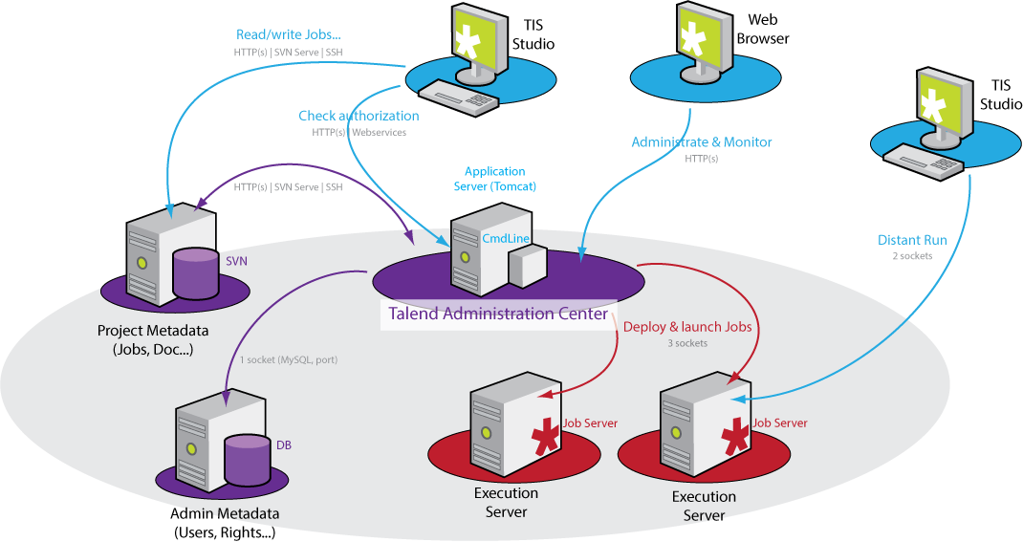
Talend - Architecture
Architecture
Talend Open Studio is an Eclipse based Java tool.
The procedures are then compiled in Java.
Talend Open Studio translates procedures in compact and fast Java.
Procedures are compiled in small Java packages, easily deployable and run-able in any Java enabled environment.

Slide 11
Talend - Architecture
Architecture
Talend Open Studio is an Eclipse based Java tool.
The procedures are then compiled in Java.
Talend Open Studio translates procedures in compact and fast Java.
Procedures are compiled in small Java packages, easily deployable and run-able in any Java enabled environment.

Slide 12
Talend – Functionalities
Database Connectivity (Oracle, MySQL ..)
File Input (Excel, Delimited File ..)
Mapping (Merge)
Batch Monitoring and Automation
Meta Data logging of Jobs
Error Logging
Notifications
Exception Handling
Cursors*

Slide 13
Talend - Install
Download Talend Open Studio for Data Integration via:
http://www.talend.com/download?qt-download_landing=3#qt-download_landing
Install Client (Complete)
Talend Open Studio : Client Only
Talend Enterprise : Client / Server

Slide 14
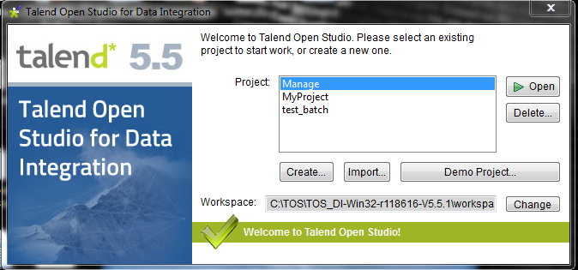
Talend – Project
Create new project or Open existing

Slide 15
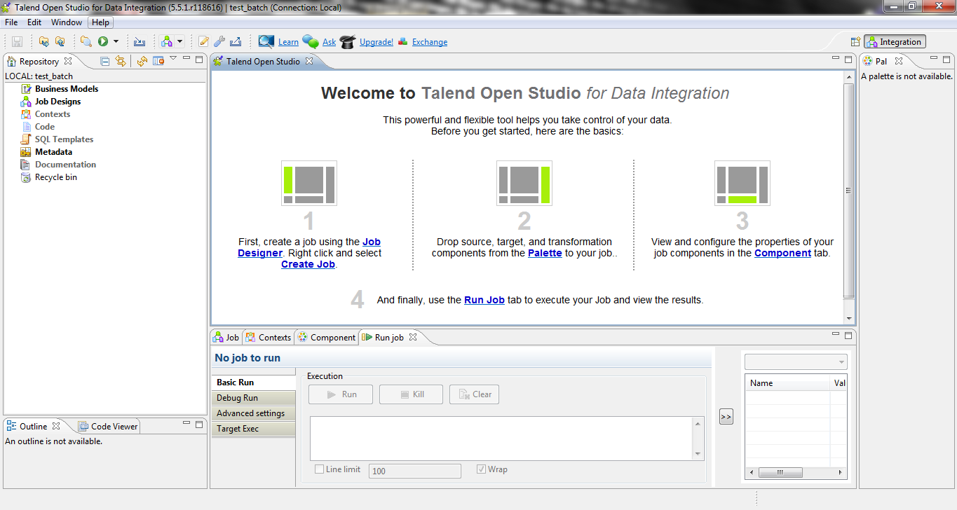
Talend – Project
Welcome Screen Talend

Slide 16
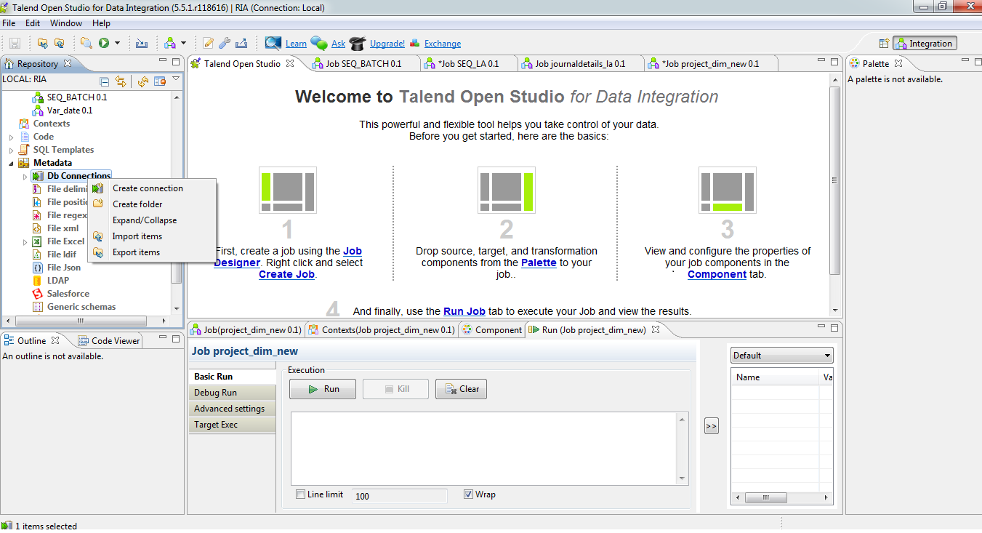
Talend – DB Connection
Creating a new Database Connection

Slide 17
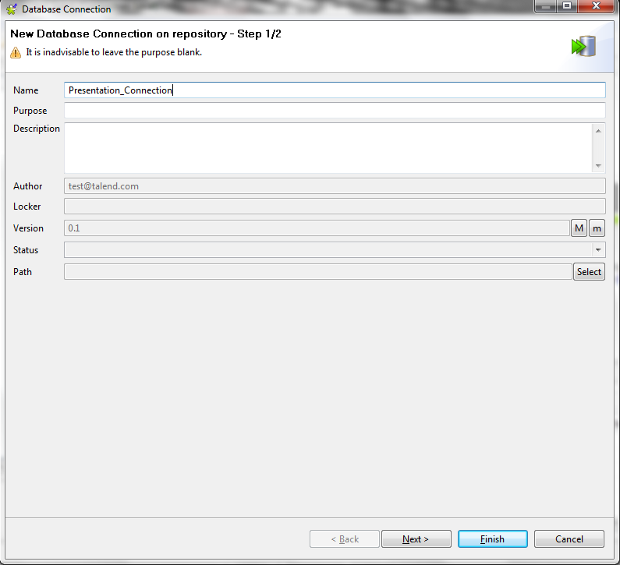
Talend – DB Connection
Specify Database Connection name

Slide 18
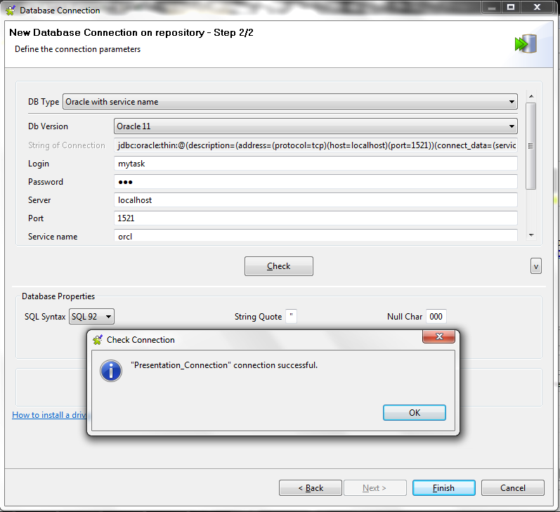
Talend – DB Connection
Enter DB Connection Details and check Connection

Slide 19
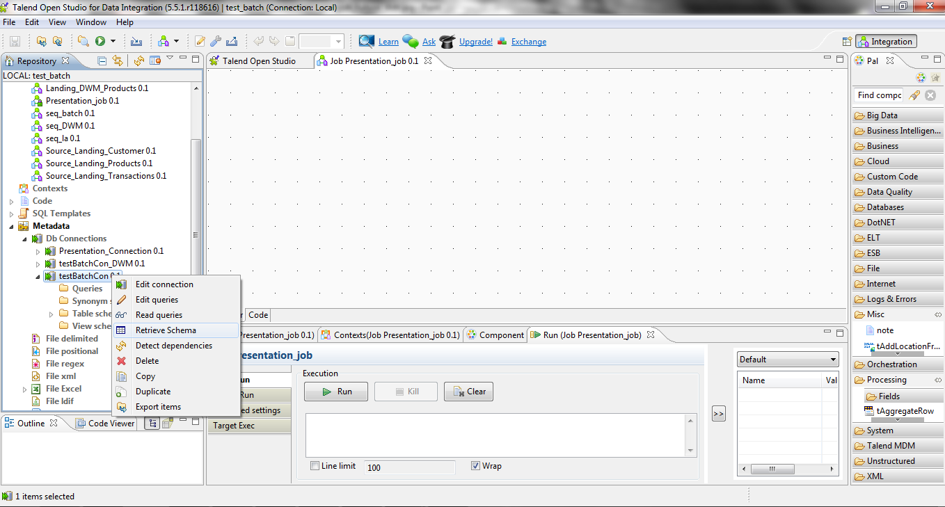
Talend – DB Connection
Retrieve Schema

Slide 20
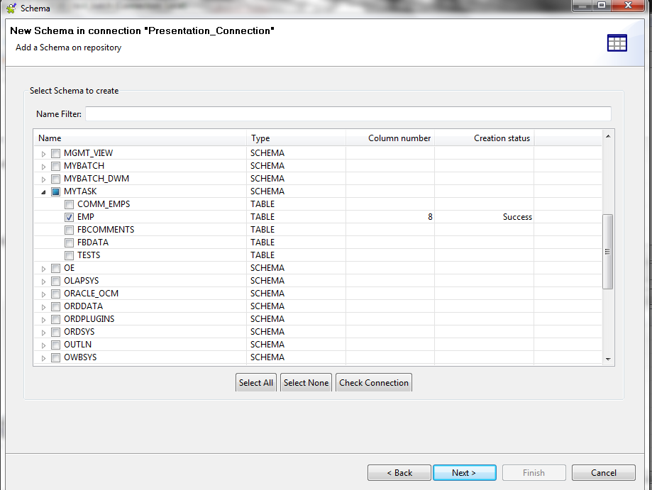
Talend – DB Connection
Specify Required Schema and Tables

Slide 21
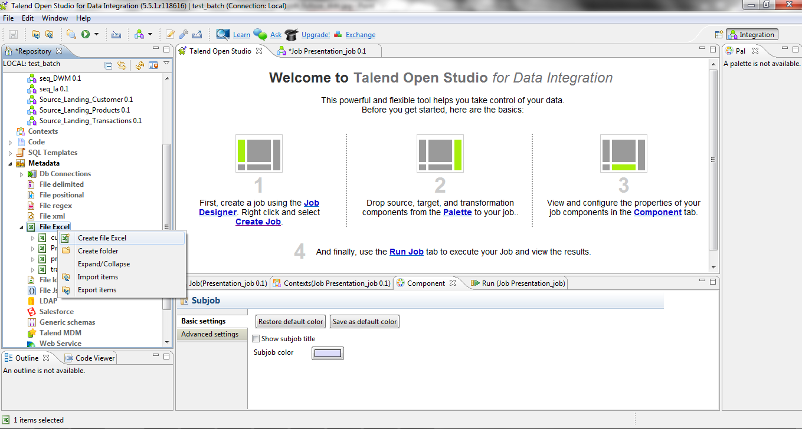
Talend – Excel Connection
Creating Connection to exsisting Excel File

Slide 22
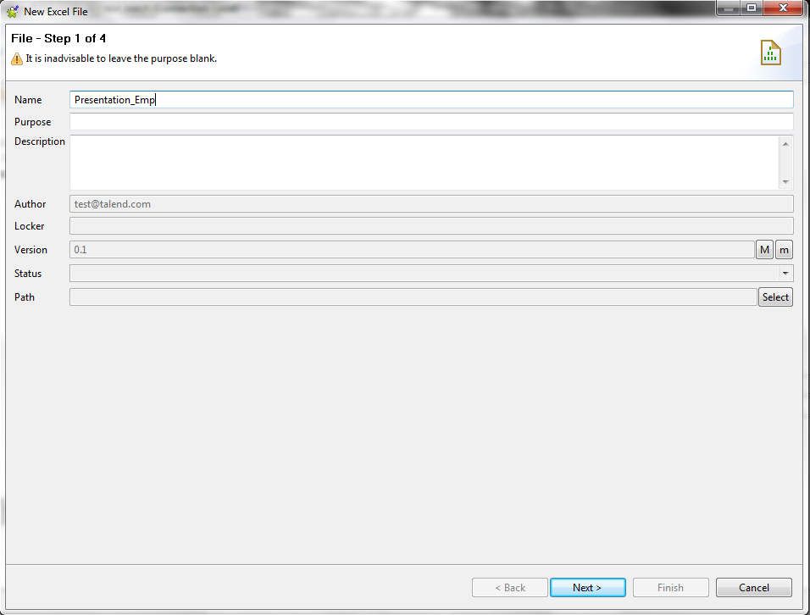
Talend – Excel Connection
New Excel File Details

Slide 23
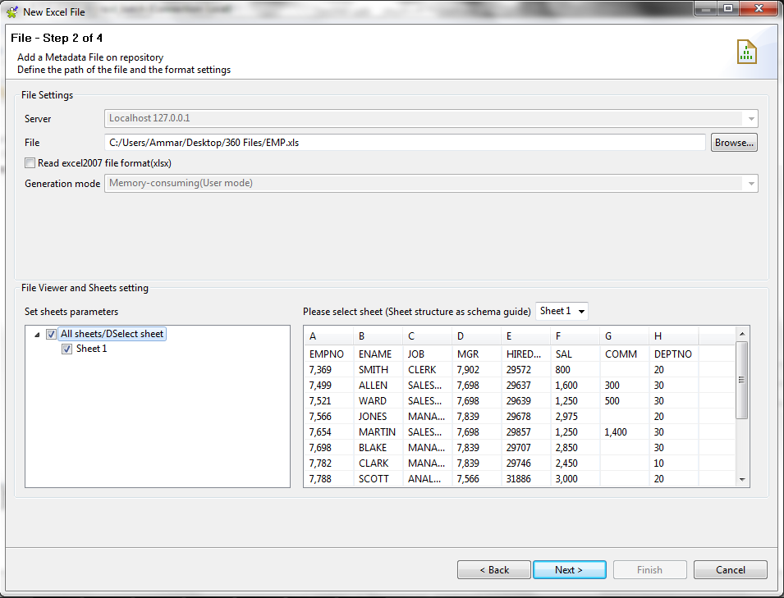
Talend – Excel Connection
Selecting File and Sheets to be used

Slide 24
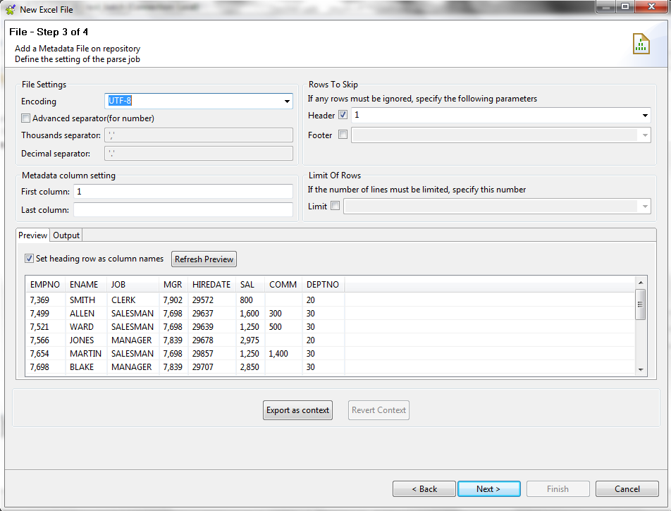
Talend – Excel Connection
Setting Headers (if any) and view data

Slide 25
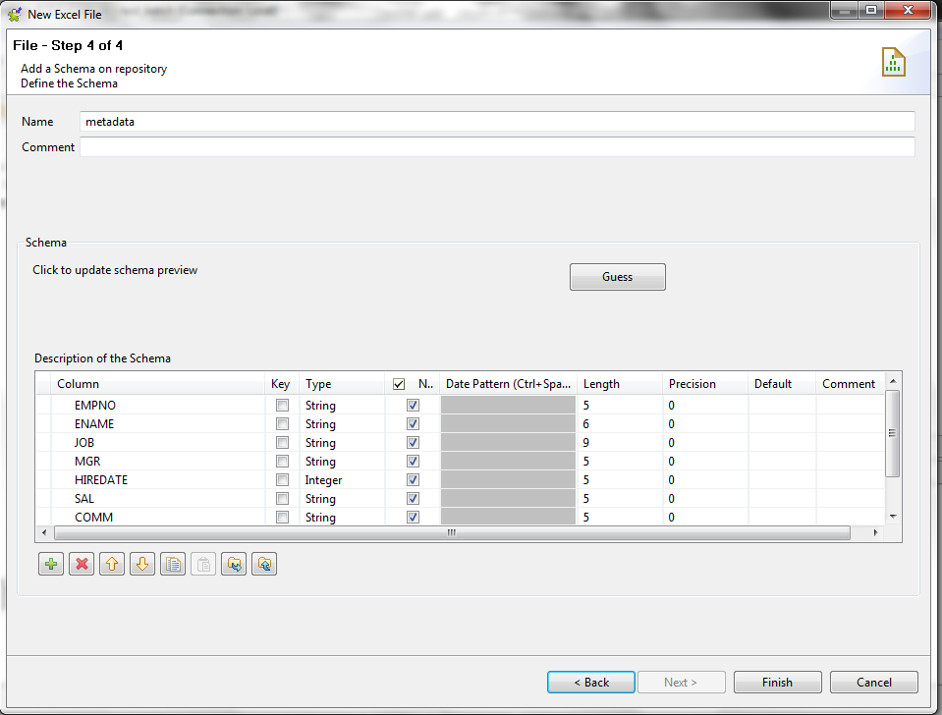
Talend – Excel Connection
Defining Schema (Default Settings)

Slide 26
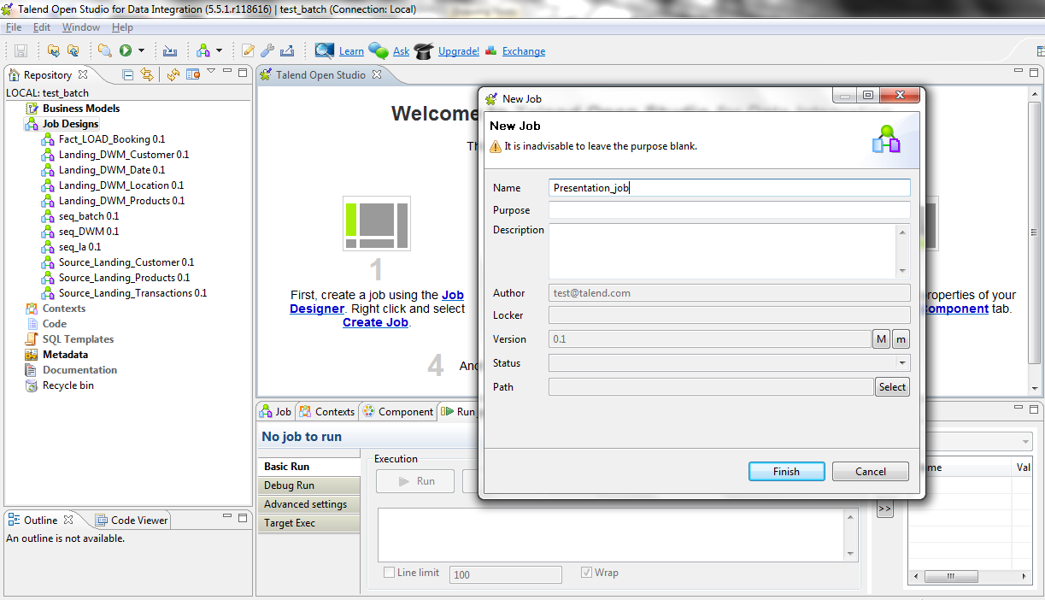
Talend - Job
Creating a new Job

Slide 27
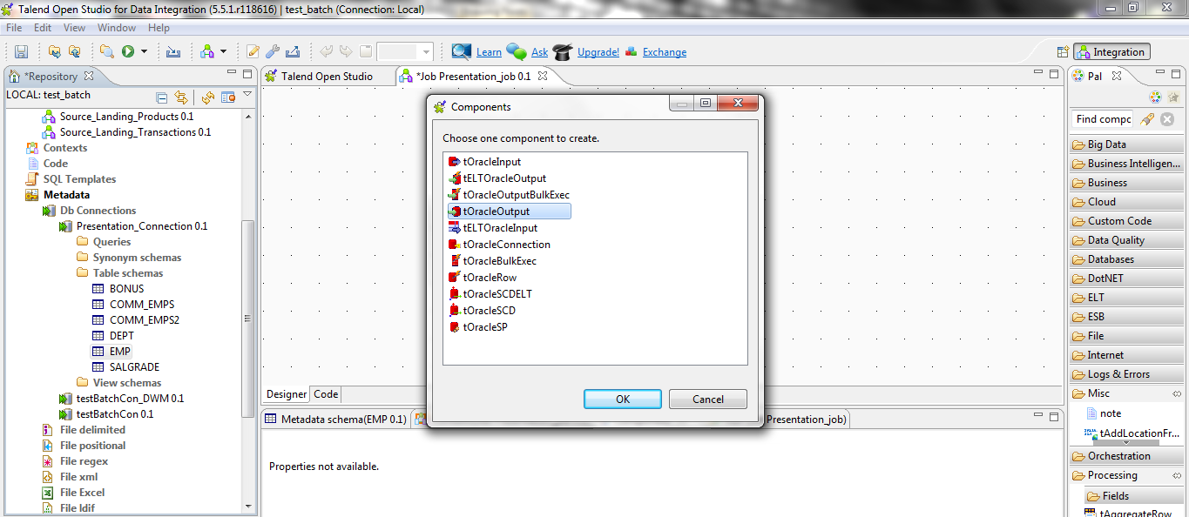
Talend - Job
Drag Drop “EMP” table as “tOracleOutput”

Slide 28
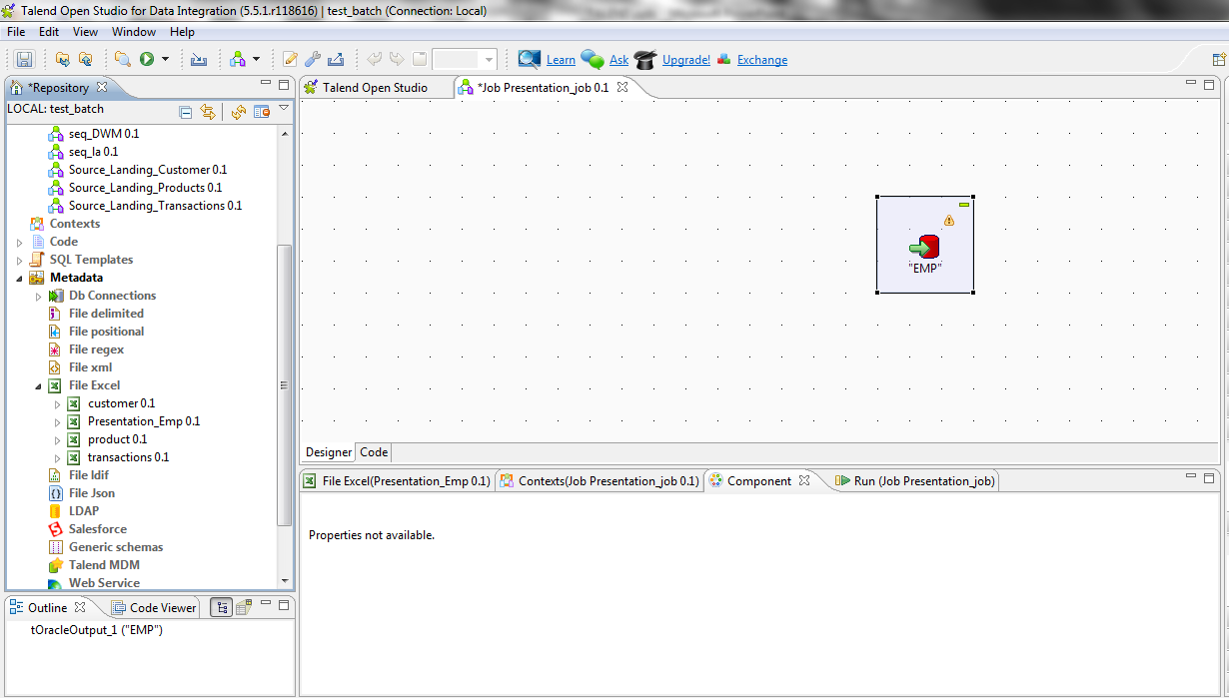
Talend - Job
View of “EMP” table as Output instance

Slide 29
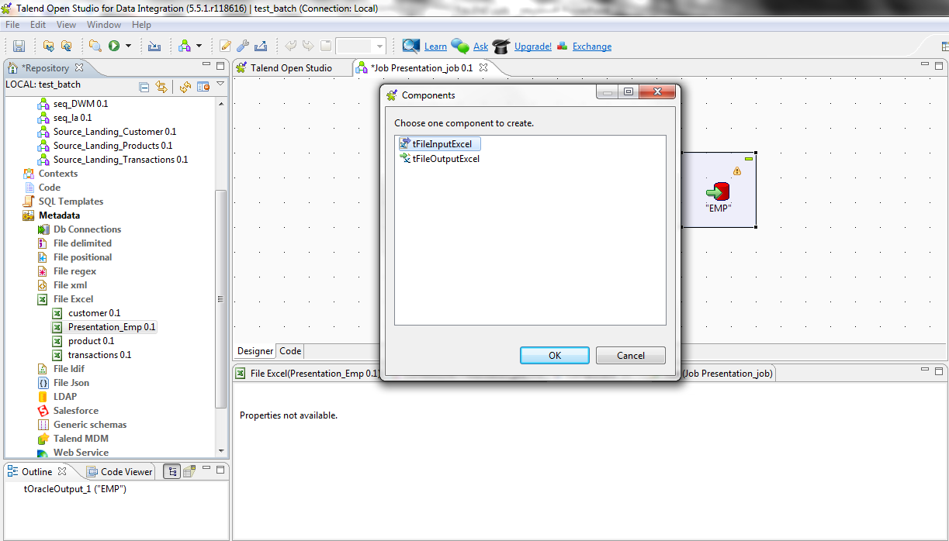
Talend - Job
Drag Drop “Presentation_Emp” excel file as “tFileInputExcel”

Slide 30
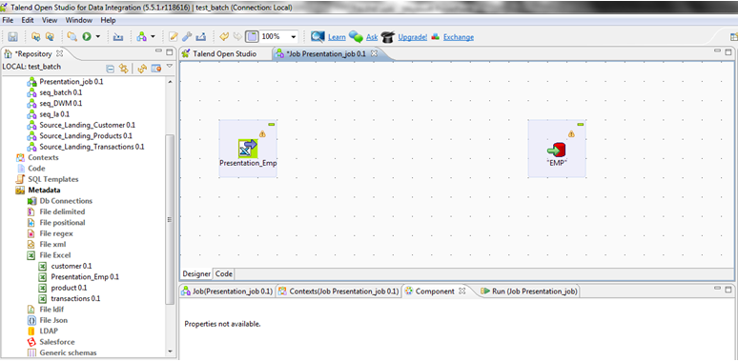
Talend - Job
View of “Presentation_Emp” excel file as Output

Slide 31
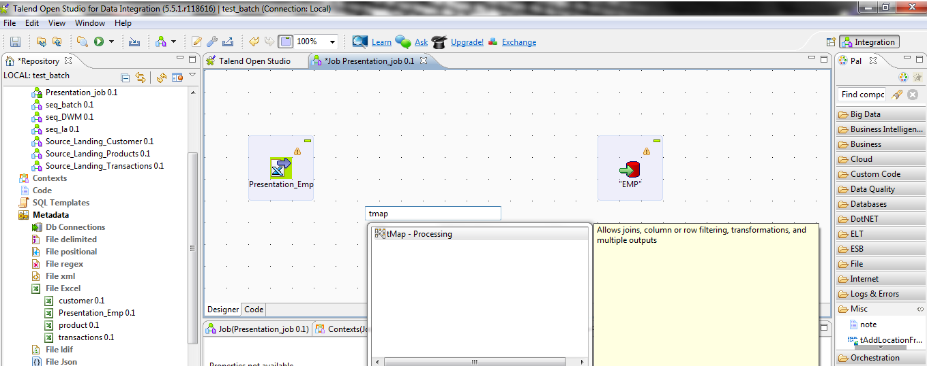
Talend - Job
Drag Drop “tMap” Component

Slide 32
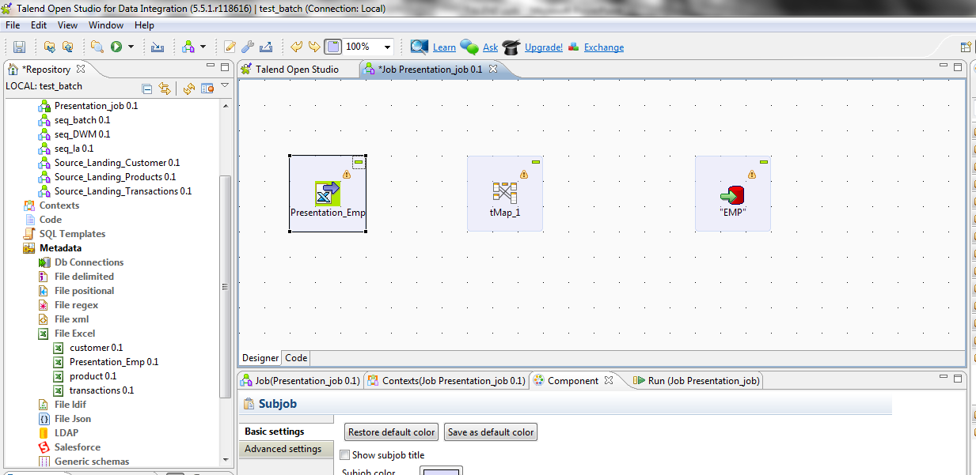
Talend - Job
View of “tMap” Component, right click and drop on “tMap” as MAIN

Slide 33
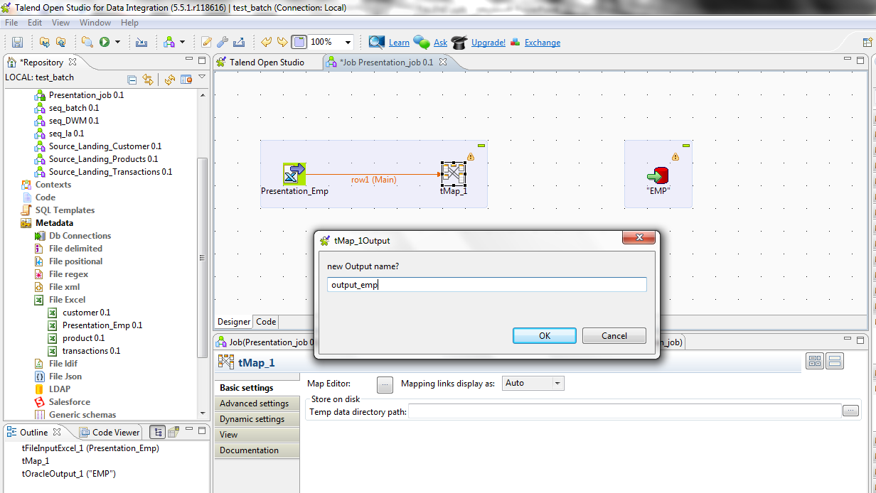
Talend - Job
Right click and Drop on “EMP” as new Output

Slide 34
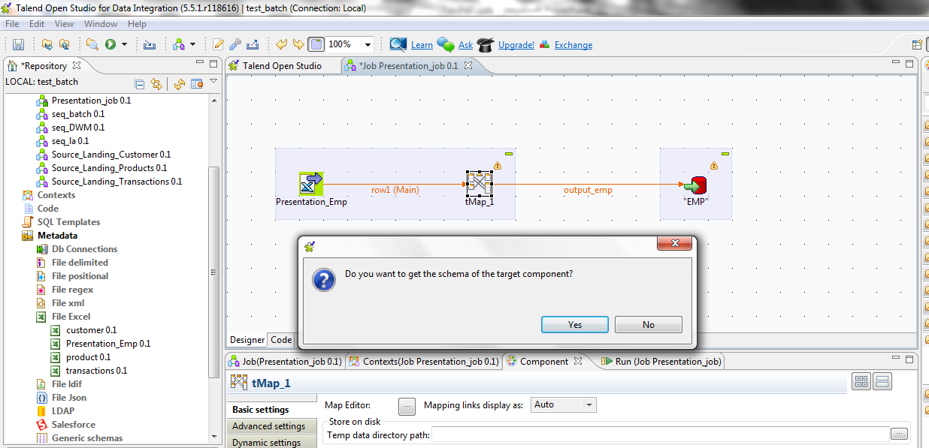
Talend - Job
Get Schema of Output to access in “tMap”

Slide 35
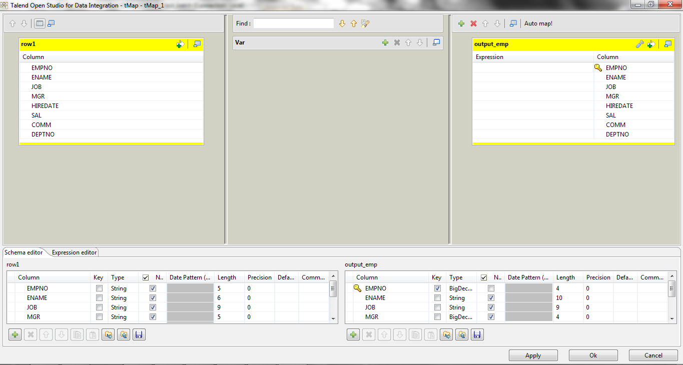
Talend - Job
View inside “tMap” (Double Click on tMap)

Slide 36
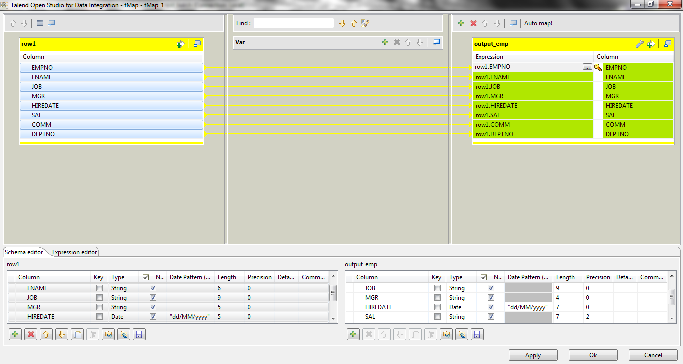
Talend - Job
Map Desired Columns of Input to Output, and set Data type of
Output columns to match Input

Slide 37
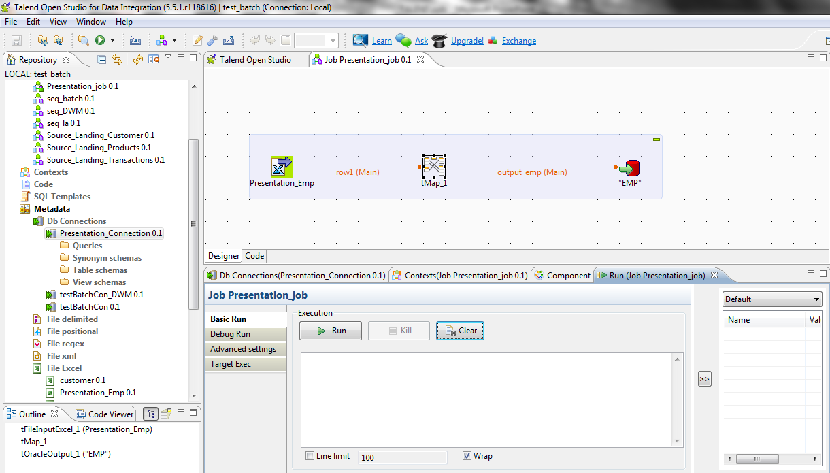
Talend - Job
View of Job

Slide 38
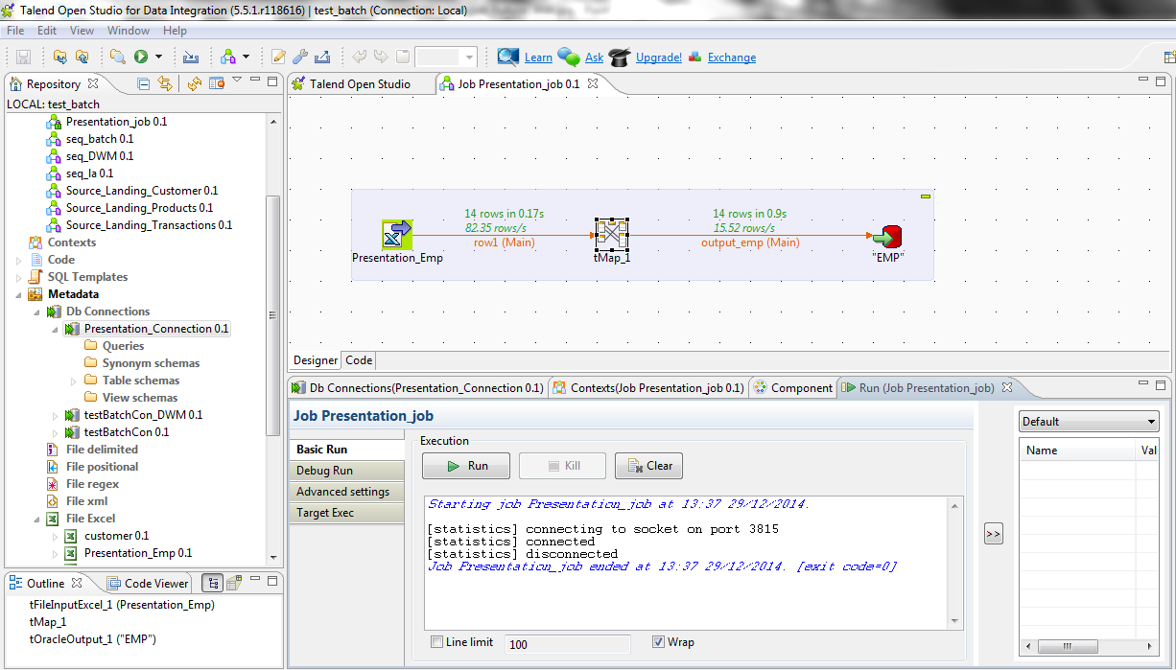
Talend - Job
Run Job

Slide 39







Talend - Components
tFileInputDelimited (Reads delimited Files).
tFileInputExcel (Reads .xls/.xlsx Files).
tFileInputJSON (Reads Json Format Files).
tFileOutputRaw (Writes Data to Text File).
tREST (Calls Online API’s : FB insights, Twitter).
tSendMail (Sends Mail to User).
tLogRow (Outputs result in table form).

Slide 40







Talend - Components
tMap (Joins, row/col filter, transformations).
tAggregateRow (Group By Function).
tStatCatcher (Listens to StatCatch Logging).
tMessageBox (Notifications).
tDie (Sends message when job over).
tWarn (Warning Message).
tServerAlive (Check Server Status).

Slide 41







Talend - Components
tFlowMeter (Records Output Count).
tReplicate (Replicates columns of data).
tPreJob (Job to run before).
tPostJob (Job to run after).
tConvertType (Conversions).
tXMLMap (To Map from XML format).
tSortRow (Sorting rows on conditions).

Slide 42


Talend - Components
tOracleConnection (Oracle-DB Connection).
tMysqlConnection (MySQL-DB Connection).

Slide 43
Talend – Best Practices
Purpose of Job
Job Architecture
Reusability
Error Handling
Restart & Recovery
Robustness
Performance (speed of execution)
Logging

